Slide 1
Lab 13
Finite State Machine Applications

Slide 2
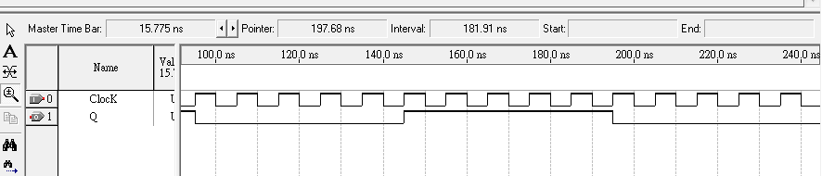
實用除頻器設計
除十之電路設計(輸出對稱方波)
module div10(Resetn, Clock, Q);
input Resetn, Clock;
output reg Q = 1'b0;
integer count = 0;
always @(negedge Resetn, posedge Clock)
if (!Resetn)
count <= 0;
else if (count == 4) begin
count <= 0;
Q <= !Q;
end
else count <= count +1;
endmodule
0
1
2
3
4
0

Slide 3
實用除頻器設計
除5電路設計(輸出非對稱方波)
module div5(Resetn, Clock, Q);
input Resetn, Clock;
output Q;
reg[2:0] count = 0;
always @(negedge Resetn, posedge Clock)
if (!Resetn)
count <= 0;
else if (count == 4)
count <= 0;
else count <= count +1;
assign Q = count[2];
endmodule

Slide 4
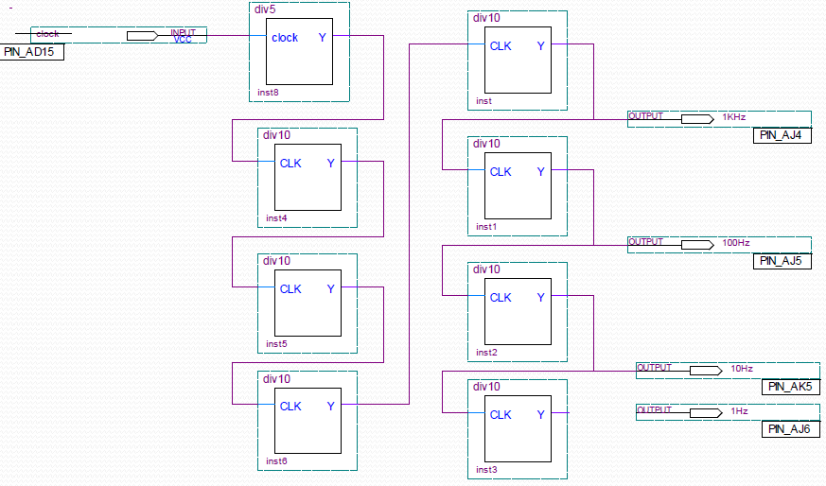
實用除頻器設計

Slide 5
實用除頻器設計
A 50MHz to 1Hz Frequency Divider
module div50M(Resetn, clk_50M, clk_1);
input Resetn, clk_50M;
output reg clk_1 = 1'b0;
integer count = 0;
always @(negedge Resetn, posedge clk_50M)
if (!Resetn)
count <= 0;
else if (count == 24999999) begin
count <= 0;
clk_1 <= !clk_1;
end
else count <= count +1;
endmodule
Frequency
Divider
1Hz
50MHz

Slide 6
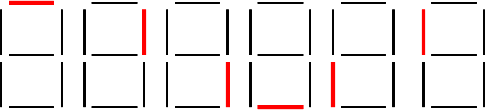
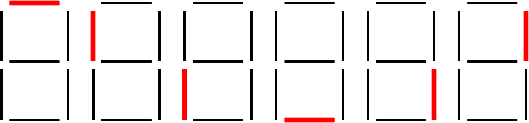
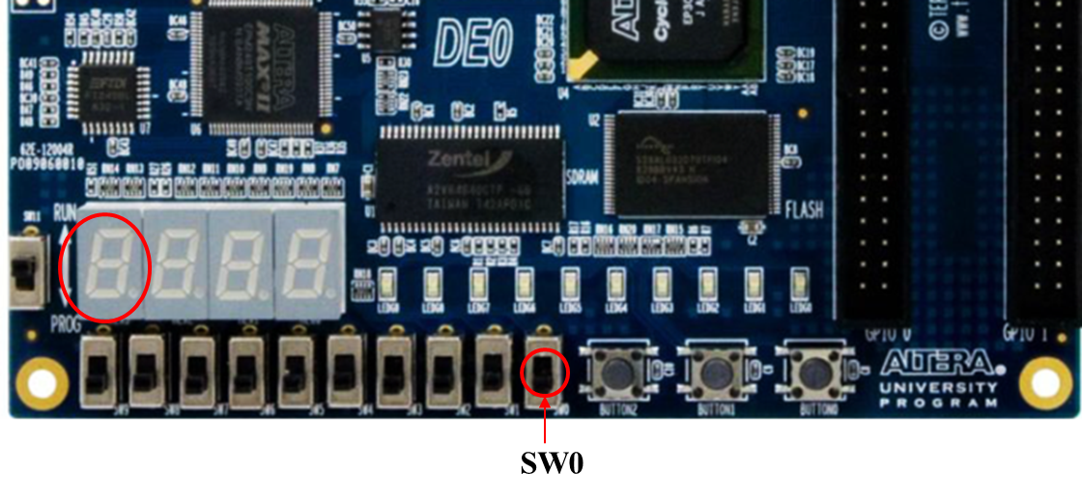
EXPERIMENT STEP (1):
Design a sequence generator to behave as follows,
The flashing frequency is 1Hz.
When SW0 = 0, the LED segments on HEX3 are flashing in a clockwise sequence as below,
When SW0 = 1, the LED segments on HEX7 are flashing in a clockwise sequence as below.

Slide 7
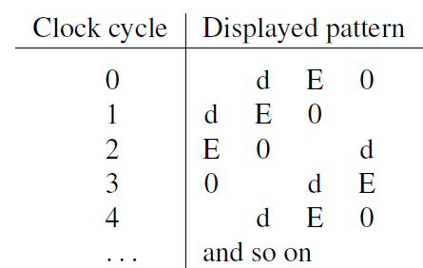
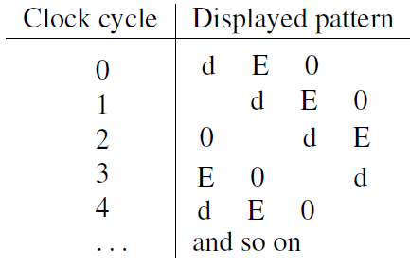
EXPERIMENT STEP (2):
Design a 4-character Rotator.
The rotating frequency is 1Hz.
When SW0 = 0, rotate the word dE0 on Hex3~0 from right to left.
When SW0 = 1, rotate the word dE0 on Hex3~0 from left to right.

Slide 8
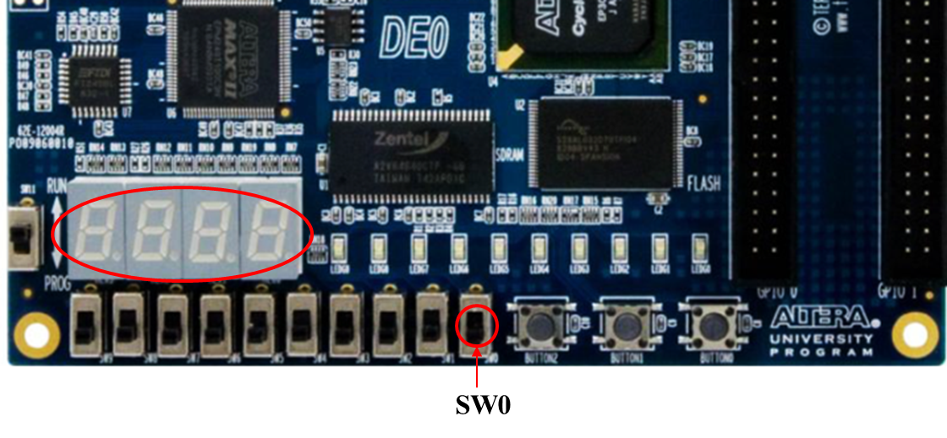
EXPERIMENT STEP (2):

